Slide 1

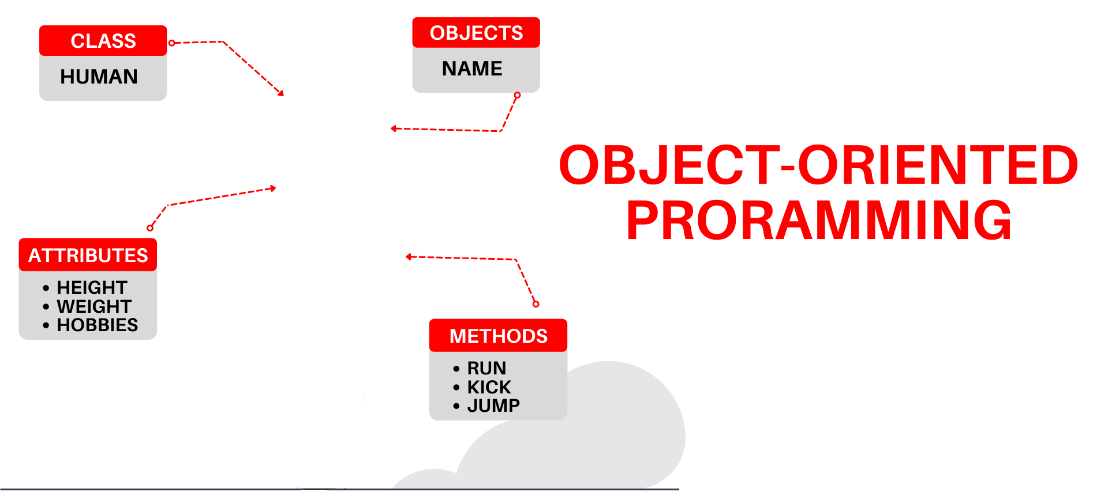

National University of Computer and Emerging Sciences
Spring 2022
Hira Naveed
Lecture # 6 Classes

Slide 2
Procedural Programming
Data is stored in a collection of variables and/or structures, along with a set of functions that perform operations on the data
The data and the functions are separate entities
double width;
double length;
displayWidth();
displayLength();
displayArea();
Data
Functions
Notes:
Shelves example

Slide 3
Limitations of Procedural Programming
Variables and data structures are passed to the functions that perform the desired operations
What if the data types or data structures change? Many functions must also be changed – Error prone
As the procedural programs become larger, function hierarchies become more complex:
difficult to understand and maintain
difficult to modify and extend

Slide 4
Object Oriented Programming
Procedural programming focuses on creating procedures, object-oriented programming focuses on creating objects
An object is a self-contained unit that consists of both data and procedures.
double width;
double length;
displayWidth();
displayLength();
displayArea();
Encapsulation refers to the combining of data and code into a single object
Data
Functions
Rectangle Object
Notes:
Shelves example

Slide 5



Some Examples of Objects
Attributes:
on (true/false)
Behavior
Switch on
Switch off
Check if on
Car
Attributes:
Gas in tank
Mileage
Behavior
Accelerate
Brake
Load fuel
Check fuel
Light Bulb
Attributes:
balance
Behavior
Deposit
Withdraw
Check balance
Bank Account
Notes:
Shelves example

Slide 6


Objects Interact with Each Other
Get Loan
Bank
Customer
Deduct Zakat
Deposit
Withdraw
Bank Account

Slide 7

Object-Oriented Programming Terminology
Class: an abstract data-type or a user-defined data type, similar to a struct (allows bundling of related variables)
Object: an instance of a class, in the same way that a variable can be an instance of a struct

Slide 8

Classes and Objects
A class is like a blueprint and objects are like houses built from the blueprint

Slide 9
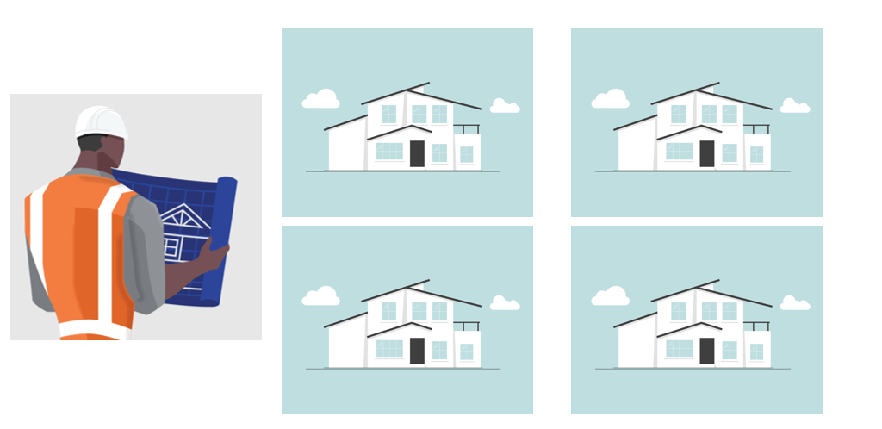
Classes and Objects
An object is an instance (realization) of a class
A single class can have multiple instances

Slide 10
Introduction to Classes
Objects are created from a class
Format:
class ClassName
{
variable declaration;
methods declaration;
};

Slide 11
Class Example
Attribute values define the state in objects
Functions define the behavior of objects
class Rectangle
{
double width;
double length;
displayWidth();
displayLength();
displayArea();
};
Data (attributes)
Functions
width = 2
length = 5
width = 4
length = 3
width = 4
length = 2

Slide 12
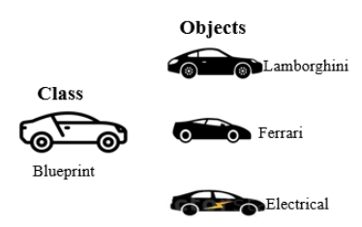
Defining an Instance of a Class
An object is an instance of a class, to create an object:
ClassName objectName;
Rectangle r;
Every object has a unique identity, its own state

Slide 13
Access Specifiers
Used to control access to members (attributes and methods) of the class
public: can be called / accessed by functions outside of the class
private: can only be called / accessed by functions that are members of the class

Slide 14
Class Example
Rule of Thumb:
Keep data attributes private and functions public
To protect data from unwanted access and modification a.k.a data hiding
class Rectangle
{
private:
double width;
double length;
public:
void displayWidth();
void displayLength();
void displayArea();
};
Private Members
Public Members

Slide 15
More on Access Specifiers
Can be listed in any order in a class
Can appear multiple times in a class
If not specified, the default is private

Slide 16
Access Specifiers
A class is similar to struct, but not the same
Members of a struct are public by default
struct Rectangle
{
double width;
double length;
} r1;
cout << r1.width; //legal because width is public
Members of a class are
private by default

Slide 17
Access Specifiers
A class is similar to struct, but not the same
Members of a class are private by default
class Rectangle
{
double width;
double length;
};
Rectangle r1; //class object
cout << r1.width; //ERROR, width is private

Slide 18
Access Specifiers
class Rectangle {
private:
double width;
double length;
public:
double getWidth(){
return width; }
};
Rectangle r1; //class object r1
cout << r1.getWidth(); //works getWidth() is public
Access any public members
of the class using the dot operator:
r1.displayArea()

Slide 19
Defining a Member Functions
Can be defined within the class declaration (in-line member function) or outside the class (out-of-line member functions)
class Rectangle {
private:
double width;
double length;
public:
double calcArea() {
return width * length; //inline func }
};

Slide 20
Defining a Member Functions
When defining a member function outside a class (out-of-line function):
Put prototype in class declaration
Define function outside using class name and scope resolution operator (::)
Combine class name with member function name
returnType ClassName::MemberFunctionName( ){
…………
}
Different classes can have member functions with the same name

Slide 21
Defining a Member Functions
class Rectangle {
private:
double width;
double length;
public:
double calcArea(); //prototype
}; //class declaration ends
double Rectangle::calcArea()
{ return width * length; //out-of-line func }

Slide 22
Defining a Member Functions
Whether member function is inline or out-of-line
Access remains the same as declared in the class
class Rectangle {
private:
double width;
double length;
public:
double calcArea(); //prototype
}; //class declaration ends
double Rectangle::calcArea()
{ return width * length; }

Slide 23
Private Member Functions
Private Member Functions:
Only accessible (callable) from member functions of the class
No direct access possible (with object instance of the class)
Can be: inline / out-of-line

Slide 24
Private Member Functions
class Rectangle {
private:
double width;
double length;
double calcArea();
public:
void displayArea(){ cout<< calcArea();}
};
double Rectangle::calcArea(){
return length * width;
}
private member function (out-of-line)

Slide 25
Using Private Member Functions
A private member function can only be called by another member function
It is used for internal processing by the class, not for use outside of the class

Slide 26
Private Member Functions
class Rectangle {
private:
double width;
double length;
double calcArea(){
return length * width;
}
public:
void displayArea(){ cout<< calcArea();}
};
private member function (inline)

Slide 27
Setters and Getters
Setter (Mutator): a member function that assigns a value to a class data member
Getter (Accessor): a function that reads/gets a value from a class data member.

Slide 28
class Rectangle {
private:
double width;
double length;
public:
void setWidth(double w){ //setter
width = w; }
void setLength(double l){ //setter
length = l; }
double getWidth(){ //getter
return width; }
double getLength(){ //getter
return length; }
}

Slide 29
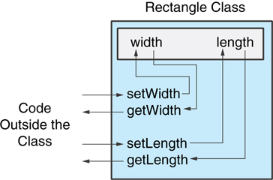
Code outside the class must use the class's public member functions to interact with the object
Constraints can be added in setters to prevent unwanted
values in data members

Slide 30
Using const With Member Functions
A const member function is read-only, cannot change the value of any attribute class Rectangle
{
private:
double width;
public:
void changeWidth() const {
width++; //ERROR }
};

Slide 31
Getters do not change an object's data, so they should be marked const.
class Rectangle { private: double width; double length; public: void setWidth(double); void setLength(double); double getWidth() const { return width; } double getLength() const { return length; } double getArea() const { return width * length; } };

Slide 32
Avoiding Stale Data
Some data is the result of a calculation.
In the Rectangle class the area of a rectangle is calculated.
length x width
If we were to use an area variable here in the Rectangle class, its value would be dependent on the length and the width.
If we change length or width without updating area, then area would become stale.
To avoid stale data, it is best to calculate the value of that data within a member function rather than store it in a variable.

Slide 33
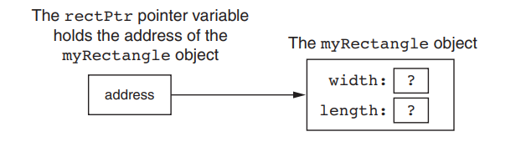
Pointer to an Object
Rectangle myRectangle; //Rectangle object
Can define a pointer to an object:
Rectangle *rPtr; //Rectangle pointer
Can access public members via pointer:
rPtr = &myRectangle;

Slide 34
Pointer to an Object
Can access public members via pointer:
rPtr = &myRectangle;
Recall you can use * and . OR ->
rPtr->setWidth(12.5);
cout << rPtr->getLength() << endl;

Slide 35
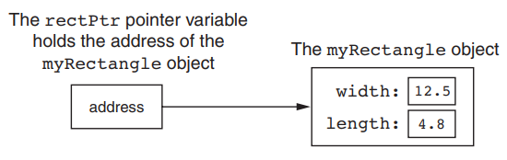
Pointer to an Object
Can access public members via pointer:
rPtr = &myRectangle;
rPtr->setWidth(12.5);
rectPtr->setLength(4.8);

Slide 36
Pointer to an Object
Dynamically allocate objects using a pointer
Rectangle *rPtr = new Rectangle;
rPtr->setLength(12.5);
rPtr->setWidth(10.3);
Deallocate memory and delete object
delete rPtr;
rPtr = NULL;

Slide 37
Reference to Objects

Slide 38
Reference to Objects
Reference is an alias to an existing object

Slide 39
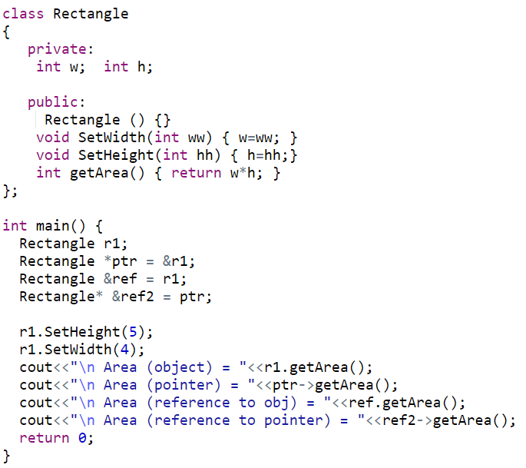
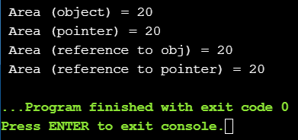
Reference and Pointers to Objects

Slide 40
Separating Specification from Implementation
Makes it easier to modify programs
Header files (.h)
Contains class definitions and function prototypes
Source-code files (.cpp)
Contains member function definitions

Slide 41
1 // Fig. 6.5: time1.h
2 // Declaration of the Time class.
3 // Member functions are defined in time1.cpp
4
5 // prevent multiple inclusions of header file
Dot ( . ) replaced with underscore ( _ ) in file name.
6 #ifndef TIME1_H
7 #define TIME1_H
8
If time1.h (TIME1_H) is not defined (#ifndef) then it is loaded (#define TIME1_H). If TIME1_H is already defined, then everything up to #endif is ignored.
This prevents loading a header file multiple times.
9 // Time abstract data type definition
10 class Time {
11 public:
12 Time(); // constructor
13 void setTime( int, int, int ); // set hour, minute, second
14 void printMilitary(); // print military time format
15 void printStandard(); // print standard time format
16 private:
17 int hour; // 0 - 23
18 int minute; // 0 - 59
19 int second; // 0 - 59
20 };
21
22 #endif
Notes:
#ifndef checks whether the given token has been #defined earlier in the file or in an included file; if not, it includes the code between it and the closing #else or, if no #else is present, #endif statement.

Slide 42
23 // Fig. 6.5: time1.cpp
24 // Member function definitions for Time class.
25 #include <iostream>
26
27 using std::cout;
Source file uses #include to load the header file
28
29 #include "time1.h"
30
31 // Time constructor initializes each data member to zero.
32 // Ensures all Time objects start in a consistent state.
33 Time::Time() { hour = minute = second = 0; }
34
35 // Set a new Time value using military time. Perform validity
36 // checks on the data values. Set invalid values to zero.
37 void Time::setTime( int h, int m, int s )
38 {
39 hour = ( h >= 0 && h < 24 ) ? h : 0;
40 minute = ( m >= 0 && m < 60 ) ? m : 0;
41 second = ( s >= 0 && s < 60 ) ? s : 0;
Source file contains function definitions
42 }
43
44 // Print Time in military format
45 void Time::printMilitary()
46 {
47 cout << ( hour < 10 ? "0" : "" ) << hour << ":"
48 << ( minute < 10 ? "0" : "" ) << minute;
49 }
50
51 // Print time in standard format
52 void Time::printStandard()
53 {
54 cout << ( ( hour == 0 || hour == 12 ) ? 12 : hour % 12 )
55 << ":" << ( minute < 10 ? "0" : "" ) << minute
56 << ":" << ( second < 10 ? "0" : "" ) << second
57 << ( hour < 12 ? " AM" : " PM" );
58 }

Slide 43
Constructors
Member function that is automatically called when an object is created
Purpose is to construct an object
Constructor function name is class name
Has no return type
A class can have multiple constructors

Slide 44
Constructors
class Demo
{
public:
Demo(); // Constructor
};
Demo::Demo() //out-of-line
{
cout << "Welcome to the constructor!\n";
}

Slide 45
Constructors
class Demo
{
public:
Demo(){ //inline function
// Constructor
cout << "Welcome to the constructor!\n";
}
};

Slide 46
Constructors
Whenever an instance of a class is created, the constructor is automatically called
Demo dem; //object dem is created
//Prints
Welcome to the constructor!

Slide 47
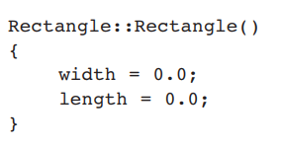
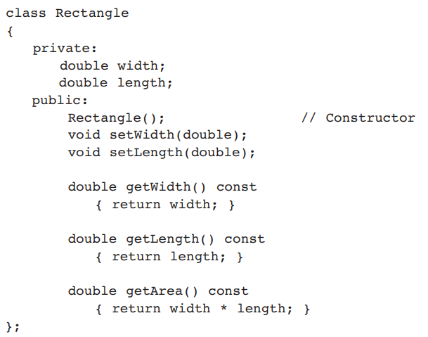
Constructors

Slide 48
What Constructors Do
Help in initializing class data members
Employee( ) { id = 0; }
Allocate memory for dynamic members
Employee() {
char* nameptr = new char[20];
}
Allocate any needed resources
Such as to open files, etc.

Slide 49
Default Constructors
A class can have only one default constructor
A default constructor is a constructor that takes no arguments
If you write a class with no constructor at all, C++ will write a default constructor for you, one that does nothing.
A simple instantiation of a class (with no arguments) calls the default constructor:
Rectangle r;

Slide 50
Parametrized Constructors
To create a constructor that takes arguments:
indicate parameters in prototype:
Rectangle(double, double);
Use parameters in the definition:
Rectangle::Rectangle(double w, double len) { width = w; length = len; }

Slide 51
Parametrized Constructors
You can pass arguments to the constructor when you create an object:
Rectangle r(10.7, 5.2);
Constructors can be overloaded
Rectangle(double w, double len, double ar) { width = w; length = len;
area = ar; }
Rectangle r(10.0, 5.0, 50.0);

Slide 52
More About Default Constructors
If all of a constructor's parameters have default arguments, then it is a default constructor. For example:
Rectangle(double len = 0, double wid = 0){
length = len; width = wid;
}
Creating an object and passing no arguments will cause this constructor to execute: Rectangle r;
Cannot create multiple default constructors - ERROR

Slide 53
More About Default Constructors
Rectangle(double len = 0, double wid = 0){
length = len; width = wid;
}
Creating an object and passing no arguments will cause this constructor to execute: Rectangle r;
Rectangle r1(10.0);
Rectangle r2(10.0, 2.0);
All three cause the same constructor to execute

Slide 54
More About Default Constructors
Rectangle(double len = 0, double wid = 0){
length = len; width = wid;
}
Creating an object and passing no arguments will cause this constructor to execute: Rectangle r;
Rectangle r1(10.0);
Rectangle r2(10.0, 2.0);
All three cause the same constructor to execute
With this constructor, cannot create any other constructor with 0,1 or 2 parameters.
Because then the compiler cannot differentiate and decide which one to call

Slide 55
Classes with No Default Constructor
When all of a class's constructors require arguments, then the class has NO default constructor.
When this is the case, you must pass the required arguments to the constructor when creating an object.

Slide 56
Destructors
Member function automatically called when an object is destroyed
Destructor name is ~classname, e.g., ~Rectangle
Has no return type; takes no arguments
Only one destructor per class, i.e., it cannot be overloaded
If constructor allocates dynamic memory, destructor should release it

Slide 57
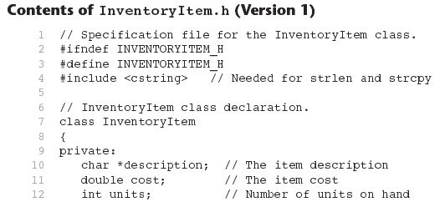
Example InventoryItem.h

Slide 58
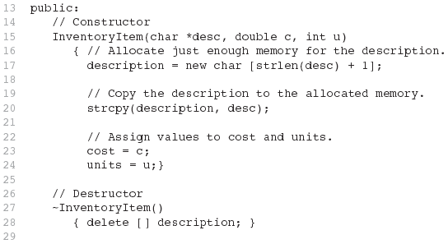
Example InventoryItem.h
(continued)

Slide 59
Constructors, Destructors, and Dynamically Allocated Objects
When an object is dynamically allocated with the new operator, its constructor executes: Rectangle *r = new Rectangle(10, 20);
When the object is destroyed, its destructor executes: delete r;

Slide 60
Only One Default Constructor and One Destructor
Do not provide more than one default constructor for a class: one that takes no arguments and one that has default arguments for all parameters
Square();
Square(int = 0); // will not compile
Since a destructor takes no arguments, there can only be one destructor for a class

Slide 61
Member Function Overloading
Non-constructor member functions can also be overloaded:
void setCost(double);
void setCost(char *);
Must have unique parameter lists, like overloaded constructors

Slide 62
When Constructors and Destructors Are Called
Constructors and destructors called automatically
Global scope objects
Constructors called before any other function (including main)
Destructors called when main terminates (or exit function called)
Local scope objects
Constructors called when objects are defined
Destructors called when objects leave scope
Notes:
Abort: Aborts the current process, producing an abnormal program termination.
exit() terminates the calling process without executing the rest code which is after the exit() function. The _Exit() function in C/C++ gives normal termination of a program without performing any cleanup tasks.

Slide 63
7 class CreateAndDestroy {
8 public:
9 CreateAndDestroy( int ); // constructor
10 ~CreateAndDestroy(); // destructor
11 private:
12 int data;
13 };
14
15 #endif
24
25 CreateAndDestroy::CreateAndDestroy( int value )
Constructor and Destructor changed to print when they are called.
26 {
27 data = value;
28 cout << "Object " << data << " constructor";
29 }
30
31 CreateAndDestroy::~CreateAndDestroy()
32 { cout << "Object " << data << " destructor " << endl; }

Slide 64
63
64 // Function to create objects
65 void create( void )
66 {
67 CreateAndDestroy fifth( 5 );
68 cout << " (local in create)" << endl;
69
70
71
72
42
73 CreateAndDestroy seventh( 7 );
43 void create( void ); // prototype
74 cout << " (local in create)" << endl;
44
75 }
45 CreateAndDestroy first( 1 ); // global object
46
47 int main()
48 {
49 cout << " (global created before main)" << endl;
50
51 CreateAndDestroy second( 2 ); // local object
52 cout << " (local in main)" << endl;
53
54
55
56
57 create(); // call function to create objects
58
59 CreateAndDestroy fourth( 4 ); // local object
60 cout << " (local in main)" << endl;
61 return 0;
62 }

Slide 65
OUTPUT
Object 1 constructor (global created before main)
Object 2 constructor (local in main)
Object 5 constructor (local in create)
Object 7 constructor (local in create)
Object 7 destructor
Object 5 destructor
Object 4 constructor (local in main)
Object 4 destructor
Object 2 destructor
Object 1 destructor
Notice how the order of the constructor and destructor call depends on the types of variables (local and global) they are associated with.

Slide 66
Destructor Example
void f1()
{
Employee *c = new Employee[3];
c[0].var1 = 322;
c[1].var1 = 5
c[2].var1 = 9;lete [] c; //destructor will call here
}

Slide 67
class Item {
private:
double cost;
int units;
public:
Item() { //Default Constructor
cost = 0.0;
units = 0; }
Item(int costVal){ //Constr 1 parameter
cost = costVal;
units = 0; }
Item(double c, int u) { //Constr 2 parameters
cost = c;
units = u; } };

Slide 68
Arrays of Objects
Objects can be the elements of an array:
Item inventory[40];
Default constructor for object is used when array is defined

Slide 69
Arrays of Objects
Must use initializer list to invoke constructor that takes arguments:
Item inventory[3] = { 22.4, 10.30, 99.0 };
The compiler treats each item in the initializer list as an argument for an array element’s constructor
Second constructor in the Item class

Slide 70
Arrays of Objects
If the constructor requires more than one argument, the initializer must take the form of a function call:
Item inventory[] = {Item(6.95, 12), Item(8.75, 20), Item(3.75, 10) };

Slide 71
Arrays of Objects
It isn't necessary to call the same constructor for each object in an array:
Item inventory[] = {20.5, Item( 8.75, 20), 45.0};

Slide 72
Accessing Objects in an Array
Objects in an array are referenced using subscripts
Member functions are referenced using dot notation:
inventory[2].setUnits(30);
cout << inventory[2].getUnits();

Slide 73
Array of pointers to objects
Declare an array of pointer to objects
Allocate and initialize each object in a loop
Date *dates[31];
for (int day = 0; day < 31; ++day)
{
dates[day] = new Date(3, day, 2020);
}
Notes:
The const property of an object goes into effect after the constructor finishes executing and ends before the class's destructor executes. So the constructor and destructor can modify the object, but other methods of the class can't.
The reason for this is that the compiler cannot decide whether a method performs write operations or only read operations with data members unless additional information is supplied.

Slide 74
Default Member-wise Assignment
Assignment operator (=) can be used to assign an object to another object of the same type.
Member-wise assignment: each data member of the object on the right of the assignment operator is assigned individually to the same data member in the object on the left

Slide 75
Default Member-wise Assignment
class Rectangle{
double length;
double width;
public:
Rectangle(){ //default constructor
length = 0; width = 0; }
//parametrized constructor
Rectangle(double l, double w) {
length = l;
width = w; }
};
//box1 is an object of class Rectangle
Rectangle box1(10.0, 20.0);
box1
length = 10.0
width = 20.0

Slide 76
Default Member-wise Assignment
//box1 is an object of class Rectangle
Rectangle box1(10.0, 20.0);
Rectangle box2;
box2 = box1;
box2
box1
length = 0.0
width = 0.0
length = 10.0
width = 20.0

Slide 77
Default Member-wise Assignment
//box1 is an object of class Rectangle
Rectangle box1(10.0, 20.0);
Rectangle box2;
box2 = box1;
Rectangle box3 = box2;
box3
box2
box1
length = 10.0
width = 20.0
length = 10.0
width = 20.0
length = 10.0
width = 20.0

Slide 80
Default Copy Constructor
A copy constructor creates an object and initializes it with another object’s data. Objects must be of the same type
If a class doesn’t have a copy constructor, C++ creates a default copy constructor for it.
Rectangle box3 = box2; OR Rectangle box3(box2);
The default copy constructor performs the member-wise assignment when an object is initialized using another object.

Slide 81
Copy constructor
A type of constructor that is used to initialize an object with another object of the same type is known as copy constructor.
It is by default available in all classes
It has the same form as other constructors, except it has a reference parameter of the same class type
syntax is ClassName(ClassName &Variable)
Rectangle(Rectangle &r)
Notes:
If we don’t define our own copy constructor, the C++ compiler creates a default copy constructor for each class which does a member-wise copy between objects.

Slide 82
Copy Constructor for Class Date
Date::Date(Date &date)
{
month = date.month;
day = date.day;
year = date.year;
}

Slide 83
Uses of the Copy Constructor
Implicitly called in 3 situations:
Dynamically defining a new object from an existing object
passing an object by value
returning an object by value
Notes:
Copy constructor is called when a new object is created from an existing object, as a copy of the existing object. Assignment operator is called when an already initialized object is assigned a new value from another existing object.

Slide 84
Copy Constructor: Defining a New Object
//parametrized constructor called
Date d1(2,28,2020);
// initialize 2 local objects from d1
Date d2(d1);// pass by value
Date d3 = d1;// return value
// init a dynamic object from d1
Date* pdate = new Date(d1);
Notes:
Copy constructor is called when a new object is created from an existing object, as a copy of the existing object. Assignment operator is called when an already initialized object is assigned a new value from another existing object.

Slide 85
Copy Constructor: Passing Objects by Value
//copy constructor called for each value arg
int dateDiff(Date d1, Date d2);
...
Date today; //default constructor called
Date d3(02, 21, 2000); //parametrized constr.
cout << dateDiff(d3, today);

Slide 86
Some Issues with the Default Copy Constructor
There are instances, where the default copy constructor can be problematic
Notes:
If we don’t define our own copy constructor, the C++ compiler creates a default copy constructor for each class which does a member-wise copy between objects.

Slide 87
class Student{
private:
char *name;
public:
Student(){ //default constructor
name = new char[12]{0};
}
void setName(char* nameVal){ //setter for name
int i=0;
while((*nameVal)!='\0'){ name[i++]=(*nameVal);
nameVal++; }
}
char* getName(){ //getter for name
return name; } };
Notes:
If we don’t define our own copy constructor, the C++ compiler creates a default copy constructor for each class which does a member-wise copy between objects.

Slide 88
s1
int main(){
Student s1;
char name1[]="Bruce Wayne";
return 0; }
name
Dynamically
allocated array
B | r | u | c | e |  | W | a | y | n | e
Notes:
If we don’t define our own copy constructor, the C++ compiler creates a default copy constructor for each class which does a member-wise copy between objects.

Slide 89
s1
int main(){
Student s1;
char name1[]="Bruce Wayne";
s1.setName(name1);
cout<<s1.getName()<<endl;
Student s2 = s1;
return 0; }
name
Dynamically
allocated array
B | r | u | c | e |  | W | a | y | n | e
s2’s default copy constructor is called
and s1’s member variable values are copied in s2
name
s2
Output
Bruce Wayne
Notes:
If we don’t define our own copy constructor, the C++ compiler creates a default copy constructor for each class which does a member-wise copy between objects.

Slide 90
s1
int main(){
Student s1;
char name1[]="Bruce Wayne";
s1.setName(name1);
cout<<s1.getName()<<endl;
Student s2 = s1;
cout<<s2.getName()<<endl;
return 0; }
name
Dynamically
allocated array
B | r | u | c | e |  | W | a | y | n | e
name
Pointers in both objects will point to the same address a.k.a shallow copy
s2
Output
Bruce Wayne
Notes:
If we don’t define our own copy constructor, the C++ compiler creates a default copy constructor for each class which does a member-wise copy between objects.

Slide 91
s1
int main(){
Student s1;
char name1[]="Bruce Wayne";
s1.setName(name1);
cout<<s1.getName()<<endl;
Student s2 = s1;
cout<<s2.getName()<<endl;
return 0; }
name
Dynamically
allocated array
B | r | u | c | e |  | W | a | y | n | e
name
s2
Output
Bruce Wayne
Bruce Wayne
Notes:
If we don’t define our own copy constructor, the C++ compiler creates a default copy constructor for each class which does a member-wise copy between objects.

Slide 92
s1
int main(){
Student s1;
char name1[]="Bruce Wayne";
s1.setName(name1);
cout<<s1.getName()<<endl;
Student s2 = s1;
cout<<s2.getName()<<endl;
char name2[]="Clark Kennt";
s2.setName(name2);
return 0; }
name
Dynamically
allocated array
B | r | u | c | e |  | W | a | y | n | e
name
s2
Output
Bruce Wayne
Bruce Wayne
Notes:
If we don’t define our own copy constructor, the C++ compiler creates a default copy constructor for each class which does a member-wise copy between objects.

Slide 93
s1
int main(){
Student s1;
char name1[]="Bruce Wayne";
s1.setName(name1);
cout<<s1.getName()<<endl;
Student s2 = s1;
cout<<s2.getName()<<endl;
char name2[]="Clark Kennt";
s2.setName(name2);
cout<<s2.getName()<<endl;
return 0; }
name
Dynamically
allocated array
C | l | a | r | k |  | K | e | n | n | t
name
s2
Output
Bruce Wayne
Bruce Wayne
Notes:
If we don’t define our own copy constructor, the C++ compiler creates a default copy constructor for each class which does a member-wise copy between objects.

Slide 94
s1
int main(){
Student s1;
char name1[]="Bruce Wayne";
s1.setName(name1);
cout<<s1.getName()<<endl;
Student s2 = s1;
cout<<s2.getName()<<endl;
char name2[]="Clark Kennt";
s2.setName(name2);
cout<<s2.getName()<<endl;
return 0; }
name
Dynamically
allocated array
C | l | a | r | k |  | K | e | n | n | t
name
s2
Output
Bruce Wayne
Bruce Wayne
Clark Kennt
Notes:
If we don’t define our own copy constructor, the C++ compiler creates a default copy constructor for each class which does a member-wise copy between objects.

Slide 95
s1
int main(){
Student s1;
char name1[]="Bruce Wayne";
s1.setName(name1);
cout<<s1.getName()<<endl;
Student s2 = s1;
cout<<s2.getName()<<endl;
char name2[]="Clark Kennt";
s2.setName(name2);
cout<<s2.getName()<<endl;
cout<<s1.getName()<<endl;
return 0; }
name
Dynamically
allocated array
C | l | a | r | k |  | K | e | n | n | t
name
s2
Output
Bruce Wayne
Bruce Wayne
Clark Kennt
Notes:
If we don’t define our own copy constructor, the C++ compiler creates a default copy constructor for each class which does a member-wise copy between objects.

Slide 96
s1
int main(){
Student s1;
char name1[]="Bruce Wayne";
s1.setName(name1);
cout<<s1.getName()<<endl;
Student s2 = s1;
cout<<s2.getName()<<endl;
char name2[]="Clark Kennt";
s2.setName(name2);
cout<<s2.getName()<<endl;
cout<<s1.getName()<<endl;
return 0; }
name
Dynamically
allocated array
C | l | a | r | k |  | K | e | n | n | t
name
s2
Output
Bruce Wayne
Bruce Wayne
Clark Kennt
Clark Kennt
Notes:
If we don’t define our own copy constructor, the C++ compiler creates a default copy constructor for each class which does a member-wise copy between objects.

Slide 97
Some Issues with Default Copy Constructor – Shallow Copy
Either object can manipulate the values stored in the array, causing the changes to show up in the other object.
One object can be destroyed, causing its destructor to be called, which frees the allocated memory
The remaining object’s name pointer would still reference this section of memory, although it should no longer be used
Notes:
If we don’t define our own copy constructor, the C++ compiler creates a default copy constructor for each class which does a member-wise copy between objects.

Slide 98
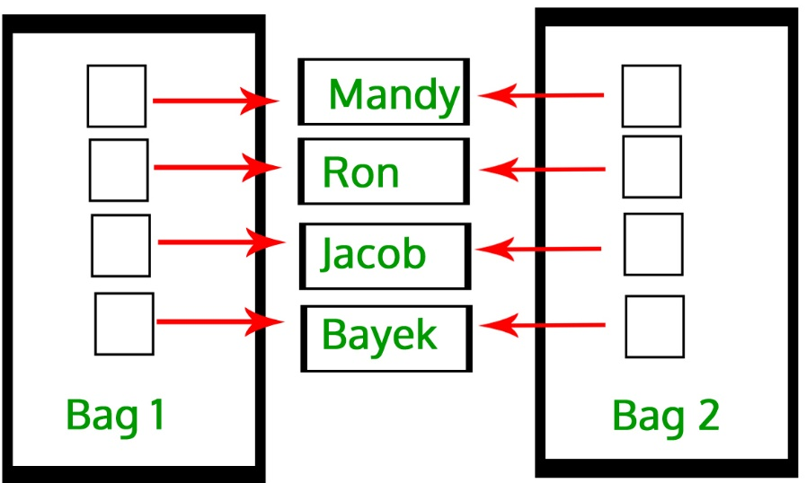
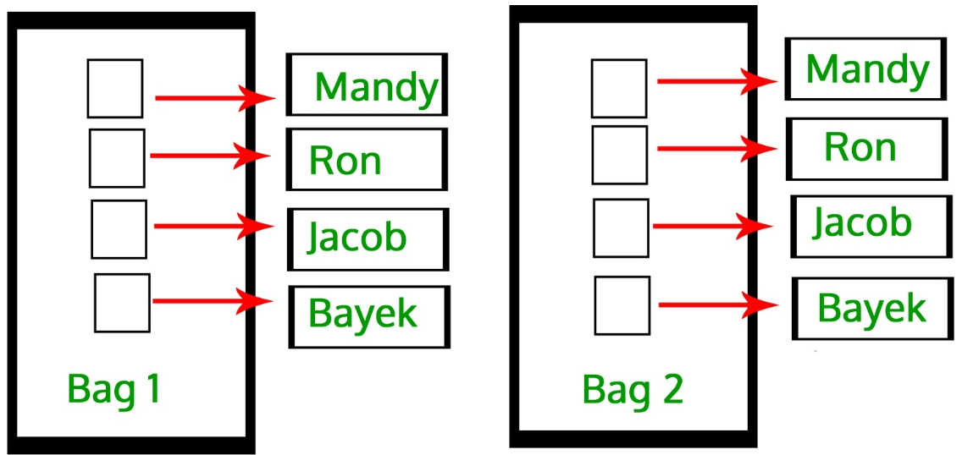
User-defined Copy Constructor, required?
Default-copy Constructor do only “Shallow Copy”
We need user-defined copy-constructor,
When we need “Deep Copy” (for Dynamic Memory)
Notes:
Useful for dynamic memory or pointers

Slide 99
User defined Copy Constructor – Deep Copy
class Student{
private:
char *name;
public:
Student(){ //default constructor
name = new char[12]{0};
}
Student(const Student &s){ //copy constructor
name = new char[12]; //for deep copy
for (int i = 0; i < 12; i++) {
name[i] = s.name[i]; }
}
};
Notes:
If we don’t define our own copy constructor, the C++ compiler creates a default copy constructor for each class which does a member-wise copy between objects.

Slide 100
s1
int main(){
Student s1;
char name1[]="Bruce Wayne";
s1.setName(name1);
cout<<s1.getName()<<endl;
Student s2 = s1;
cout<<s2.getName()<<endl;
char name2[]="Clark Kennt";
s2.setName(name2);
return 0; }
name
Dynamically
allocated array
B | r | u | c | e |  | W | a | y | n | e
B | r | u | c | e |  | W | a | y | n | e
name
Output
Bruce Wayne
Bruce Wayne
s2
Notes:
If we don’t define our own copy constructor, the C++ compiler creates a default copy constructor for each class which does a member-wise copy between objects.

Slide 101
s1
int main(){
Student s1;
char name1[]="Bruce Wayne";
s1.setName(name1);
cout<<s1.getName()<<endl;
Student s2 = s1;
cout<<s2.getName()<<endl;
char name2[]="Clark Kennt";
s2.setName(name2);
cout<<s2.getName()<<endl;
cout<<s1.getName()<<endl;
return 0; }
name
Dynamically
allocated array
B | r | u | c | e |  | W | a | y | n | e
C | l | a | r | k |  | K | e | n | n | t
name
Output
Bruce Wayne
Bruce Wayne
Clark Kennt
Bruce Wayne
s2
Notes:
If we don’t define our own copy constructor, the C++ compiler creates a default copy constructor for each class which does a member-wise copy between objects.

Slide 102
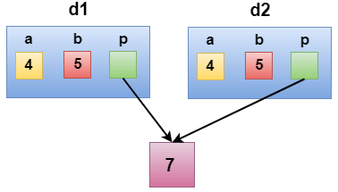
Shallow Copy
class Demo
{
int a;
int b;
int *p;
public:
Demo()
{
p=new int;
}
void setdata(int x,int y,int z)
{
a=x;
b=y;
*p=z;
}
void showdata()
{
std::cout << "value of a is : " <<a<< std::endl;
std::cout << "value of b is : " <<b<< std::endl;
std::cout << "value of *p is : " <<*p<< std::endl;
}
};
int main()
{
Demo d1;
d1.setdata(4,5,7);
Demo d2 = d1;
d2.showdata();
return 0;
}

Slide 103
Deep Copy
class Demo
{
public:
int a;
int b;
int *p;
Demo()
{
p=new int;
}
Demo(Demo &d)
{
a = d.a;
b = d.b;
p = new int;
*p = *(d.p);
}
void setdata(int x,int y,int z)
{
a=x;
b=y;
*p=z;
}

Slide 104
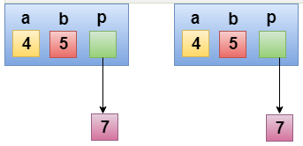
Deep Copy
void showdata()
{
std::cout << "value of a is : " <<a<< std::endl;
std::cout << "value of b is : " <<b<< std::endl;
std::cout << "value of *p is : " <<*p<< std::endl;
}
};
int main()
{
Demo d1;
d1.setdata(4,5,7);
Demo d2 = d1;
d2.showdata();
return 0;
}

Slide 105
Copy Constructor for Class Date
Copy constructors have to use reference parameters so they have access to their argument’s data.
To prevent the copy constructor from modifying the arguments data, make the copy constructors’ parameters constant
Date::Date(const Date &date)
{ month = date.month;
day = date.day;
year = date.year;
}

Slide 106

Class Instance Variables (Attributes)
class Car {
int fuel;
string model;
Car() { //constructor
fuel = 0;
model = “”;}
};
Car car1, car2, car3;
public:
fuel=0;
model=“”;
fuel=0;
model=“”;
fuel=0;
model=“”;
car1
car2
car3

Slide 107
Class Instance Variables (Attributes)
class Car {
int fuel;
string model;
Car() { //constructor
fuel = 0;
model = “”;}
};
Car car1, car2, car3;
//assume class has a setter
car1.setFuel(50);
public:
fuel=0;
model=“”;
fuel=0;
model=“”;
fuel=0;
model=“”;
car1
car2
car3

Slide 108
Class Instance Variables (Attributes)
class Car {
int fuel;
string model;
Car() { //constructor
fuel = 0;
model = “”;}
};
Car car1, car2, car3;
//assume class has a setter
car1.setFuel(50);
car2.setFuel(30);
public:
fuel=50;
model=“”;
fuel=0;
model=“”;
fuel=0;
model=“”;
car1
car2
car3

Slide 109
Class Instance Variables (Attributes)
class Car {
int fuel;
string model;
Car() { //constructor
fuel = 0;
model = “”;}
};
Car car1, car2, car3;
//assume class has a setter
car1.setFuel(50);
car2.setFuel(30);
car3.setFuel(84);
public:
fuel=50;
model=“”;
fuel=30;
model=“”;
fuel=0;
model=“”;
car1
car2
car3

Slide 110
Class Instance Variables (Attributes)
Each class object has its own copy of the class’s member variables.
class Car {
int fuel;
string model;
Car() { //constructor
fuel = 0;
model = “”;}
};
Car car1, car2, car3;
//assume class has a setter
car1.setFuel(50);
car2.setFuel(30);
car3.setFuel(84);
public:
fuel=50;
model=“”;
fuel=30;
model=“”;
fuel=84;
model=“”;
car1
car2
car3

Slide 111
static Class Members
Class members include instance variables and functions
It is possible to create a member variable or member function that does not belong to any instance of a class.
Such members are known as a static member variables and static member functions.
You can think of static class members as belonging to the class instead of to an instance of the class

Slide 112
static Member Variables
When a member variable is static, there will be only one copy of it in memory, regardless of the number of instances of the class that might exist.
A single copy of a class’s static member variable is shared by all objects of the class
Static member variables exist even if no instances (objects) of the class exist

Slide 113
class Car {
int fuel;
string model;
static int totalCars;
Car() { //constructor
fuel = 0;
model = “”; }
};
int Car::totalCars;
Car car1,car2,car3;
public:
totalCars = 0
(static)
fuel=0;
model=“”;
fuel=0;
model=“”;
fuel=0;
model=“”;
car1
car2
car3

Slide 114
class Car {
int fuel;
string model;
static int totalCars;
Car() { //constructor
fuel = 0;
model = “”;
totalCars++; }
};
int Car::totalCars;
Car car1,car2,car3;
public:
totalCars = 0
(static)
fuel=0;
model=“”;
car1

Slide 115
class Car {
int fuel;
string model;
static int totalCars;
Car() { //constructor
fuel = 0;
model = “”;
totalCars++; }
};
int Car::totalCars;
Car car1,car2,car3;
public:
totalCars = 1
(static)
fuel=0;
model=“”;
car1

Slide 116
class Car {
int fuel;
string model;
static int totalCars;
Car() { //constructor
fuel = 0;
model = “”;
totalCars++; }
};
int Car::totalCars;
Car car1,car2,car3;
public:
totalCars = 1
(static)
fuel=0;
model=“”;
fuel=0;
model=“”;
car1
car2

Slide 117
class Car {
int fuel;
string model;
static int totalCars;
Car() { //constructor
fuel = 0;
model = “”;
totalCars++; }
};
int Car::totalCars;
Car car1,car2,car3;
public:
totalCars = 2
(static)
fuel=0;
model=“”;
fuel=0;
model=“”;
car1
car2

Slide 118
class Car {
int fuel;
string model;
static int totalCars;
Car() { //constructor
fuel = 0;
model = “”;
totalCars++; }
};
int Car::totalCars;
Car car1,car2,car3;
public:
totalCars = 2
(static)
fuel=0;
model=“”;
fuel=0;
model=“”;
fuel=0;
model=“”;
car1
car2
car3

Slide 119
class Car {
int fuel;
string model;
static int totalCars;
Car() { //constructor
fuel = 0;
model = “”;
totalCars++; }
};
int Car::totalCars;
Car car1,car2,car3;
public:
totalCars = 3
(static)
fuel=0;
model=“”;
fuel=0;
model=“”;
fuel=0;
model=“”;
car1
car2
car3

Slide 120
static Member Variables
Shared by all objects of a class
Efficient, when a single copy of data is enough
Only the static variable has to be updated
May seems like global variables, but have class scope
only accessible to objects of same class
Exist even if no instances (objects) of the class exist
Can be public or private

Slide 121
static Member Variables
This external definition statement causes the variable to be created in memory and is required.
Two-Step Procedure:
Declare (Inside Class): static int radius;
Define (Outside Class): int Circle::radius;
Static Variables
Default Initialization: 0 or Null (for pointers)
Initialization: user defined value
Initialization is made just once, at compile time.
Accessibility: Private or Public
Notes:
This external definition statement causes the variable to be created in memory and is compulsory.

Slide 122
Public static Member Variables
Can be accessed using class name:
cout << Car::totalCars;
Can be accessed via any class’ object:
cout << car1.totalCars;
Can be accessed via Non-Static member functions:
Must create object first
cout << car1.getCars();
Can be accessed via Static member functions:
cout << Car::getTotalCars(); cout << car1.getTotalCars(); //public static
Notes:
There is no this pointer for static functions, they exist independent of objects
However, sharing variables across object instances and making variables accessible are independent of each other. There are four combinations of (shared, accessible) pairs. All four are available to you:
public static variable is shared and accessible outside the class
private static variable is shared, but not accessible outside the class
public non-static variable is not shared, but accessible outside the class
private non-static variable is neither shared nor accessible outside the class

Slide 123
Private static Member Variables
Cannot be accessed using class name:
// ERROR → cout << Car::totalCars;
Cannot be accessed via class' object:
// ERROR → cout << car1.totalCars;
Can be accessed via Non-Static member functions:
Must create object first
cout << car1.getCars();
Can be accessed via Static member functions:
cout << Car::getTotalCars();
cout << car1.getTotalCars(); //public static
Notes:
There is no this pointer for static functions, they exist independent of objects
However, sharing variables across object instances and making variables accessible are independent of each other. There are four combinations of (shared, accessible) pairs. All four are available to you:
public static variable is shared and accessible outside the class
private static variable is shared, but not accessible outside the class
public non-static variable is not shared, but accessible outside the class
private non-static variable is neither shared nor accessible outside the class

Slide 124
static Member Variables
The lifetime of a class’s static member variable is the lifetime of the program
This means that a class’s static member variables come into existence before any instances of the class are created

Slide 125
static Member Functions
Static member functions can operate only on static member variables.
You can think of static member functions as belonging to the class instead of to an instance of the class.
Static member functions can be called without creating any class objects

Slide 126
static Member Functions
class Car {
int fuel;
string model;
static int totalCars;
Car() { //constructor
fuel = 0;
model = “”;
totalCars++; }
static int getTotalCars(){
return totalCars; //only access static members }
};
int Car::totalCars;

Slide 127
static Member Functions
Non-static function:
Can access: all class members
Static functions:
Can access: static data and static functions
Cannot access: non-static data, non-static functions, and this pointer

Slide 128
Public static Member Functions
Can be invoked using any class object:
cout << car1.getTotalCars();
Can be invoked using class name:
cout << Car:: getTotalCars();

Slide 129
Private static Member Functions
Cannot be invoked using class objects
//ERROR → cout << e1.getCount();
Cannot be invoked using class name
//ERROR → cout << Employee::getCount();
Can be invoked within class:
Static member functions
Non-static member functions

Slide 130
1 // Fig. 7.9: employ1.h
2 // An employee class
3 #ifndef EMPLOY1_H
4 #define EMPLOY1_H
5
6 class Employee {
7 public:
8 Employee( const char*, const char* ); // constructor
9 ~Employee(); // destructor
10 const char *getFirstName() const; // return first name
11 const char *getLastName() const; // return last name
12
13 // static member function
14 static int getCount(); // return # objects instantiated
15
16 private:
static member function and variable declared.
17 char *firstName;
18 char *lastName;
19
20 // static data member
21 static int count; // number of objects instantiated
22 };
23
24 #endif

Slide 131
25 // Fig. 7.9: employ1.cpp
26 // Member function definitions for class Employee
27 #include <iostream>
28
29 using std::cout;
30 using std::endl;
static data member count and function getCount( ) initialized (required).
31
32 #include <cstring>
33 #include <cassert>
34 #include "employ1.h"
35
36 // Initialize the static data member
37 int Employee::count = 0;
38
39 // Define the static member function that
40 // returns the number of employee objects instantiated.
41 int Employee::getCount() { return count; }
42
43 // Constructor dynamically allocates space for the
44 // first and last name and uses strcpy to copy
45 // the first and last names into the object
46 Employee::Employee( const char *first, const char *last )
47 {
48 firstName = new char[ strlen( first ) + 1 ];
49 assert( firstName != 0 ); // ensure memory allocated
static data member count changed when a constructor/destructor called.
50 strcpy( firstName, first );
51
52 lastName = new char[ strlen( last ) + 1 ];
53 assert( lastName != 0 ); // ensure memory allocated
54 strcpy( lastName, last );
55
56 ++count; // increment static count of employees
Notes:
Assertions are statements used to test assumptions made by programmer. For example, we may use assertion to check if pointer returned by malloc() is NULL or not.
Following is syntax for assertion.
void assert( int expression ); If expression evaluates to 0 (false), then the expression, sourcecode filename, and line number are sent to the standard error, and then abort() function is called., Otherwise moves to next statement

Slide 132
57 cout << "Employee constructor for " << firstName
58 << ' ' << lastName << " called." << endl;
59 }
60
61 // Destructor deallocates dynamically allocated memory
62 Employee::~Employee()
static data member count changed when a constructor/destructor called.
63 {
64 cout << "~Employee() called for " << firstName
65 << ' ' << lastName << endl;
66 delete [] firstName; // recapture memory
Count decremented because of destructor calls from delete.
67 delete [] lastName; // recapture memory
68 --count; // decrement static count of employees
69 }
70
71 // Return first name of employee
72 const char *Employee::getFirstName() const
73 {
74 // Const before return type prevents client from modifying
75 // private data. Client should copy returned string before
76 // destructor deletes storage to prevent undefined pointer.
77 return firstName;
78 }
79
80 // Return last name of employee
81 const char *Employee::getLastName() const
82 {
83 // Const before return type prevents client from modifying
84 // private data. Client should copy returned string before
85 // destructor deletes storage to prevent undefined pointer.
86 return lastName;
87 }

Slide 133
88 // Fig. 7.9: fig07_09.cpp
89 // Driver to test the employee class
90 #include <iostream>
If no Employee objects exist getCount must be accessed using the class name and (::).
91
count incremented because of constructor calls from new.
92 using std::cout;
93 using std::endl;
94
95 #include "employ1.h"
96
Number of employees before instantiation is 0
97 int main()
98 {
99 cout << "Number of employees before instantiation is "
100 << Employee::getCount() << endl; // use class name
e2Ptr->getCount() or Employee::getCount() would also work.
101
102 Employee *e1Ptr = new Employee( "Susan", "Baker" );
103 Employee *e2Ptr = new Employee( "Robert", "Jones" );
104
Number of employees after instantiation is 2
105 cout << "Number of employees after instantiation is "
106 << e1Ptr->getCount();
107
Employee constructor for Susan Baker called.
Employee constructor for Robert Jones called.
108 cout << "\n\nEmployee 1: "
109 << e1Ptr->getFirstName()
110 << " " << e1Ptr->getLastName()
Employee 1: Susan Baker
Employee 2: Robert Jones
111 << "\nEmployee 2: "
112 << e2Ptr->getFirstName()
113 << " " << e2Ptr->getLastName() << "\n\n";
114
115 delete e1Ptr; // free memory
~Employee() called for Susan Baker
~Employee() called for Robert Jones
116 e1Ptr = 0;
117 delete e2Ptr; // free memory
118 e2Ptr = 0;

Slide 134
119
120 cout << "Number of employees after deletion is "
121 << Employee::getCount() << endl;
122
123 return 0;
count back to zero.
124 }
Number of employees before instantiation is 0
Employee constructor for Susan Baker called.
Employee constructor for Robert Jones called.
Number of employees after instantiation is 2
Employee 1: Susan Baker
Employee 2: Robert Jones
~Employee() called for Susan Baker
~Employee() called for Robert Jones
Number of employees after deletion is 0

Slide 135

static Class Members
Calling a static member
function of a class using
the object
Calling a static member
function of a class using
the class name

Slide 136
this Pointer
The this pointer is a special built-in pointer that is available to a class’s non-static member functions.
It always points to the instance of the class making the function call.
The this pointer is passed as a hidden argument to all non-static member functions.
void setFuel(int fuel, Car* const this) {
this->fuel = fuel;
}
Notes:
C++ this Pointer. Every object in C++ has access to its own address through an important pointer called this pointer. The this pointer is an implicit parameter to all member functions. Therefore, inside a member function, this may be used to refer to the invoking object.

Slide 137
this Pointer
void setFuel(int fuel, Car* const this) {
this->fuel = fuel;
}
Car car1, car2;
car1.setFuel(20); // this pointer points at car1
car2.setFuel(40); // this pointer points at car2
this pointer is a constant pointer that references to the calling object.
Notes:
C++ this Pointer. Every object in C++ has access to its own address through an important pointer called this pointer. The this pointer is an implicit parameter to all member functions. Therefore, inside a member function, this may be used to refer to the invoking object.

Slide 138
Using the this Pointer
Not part of the object itself
Can be used to access instance variables within member functions (including constructors and destructors)
this pointer stores the address of the calling object
For a member function print data member x, either
this->x;
or
(*this).x

Slide 139
Using the this Pointer
Useful when function parameters and class member variables have the same name
//Parametrized Constructor
Car(int fuel, string model) {
this->fuel = fuel;
this->model = model;
}

Slide 140
Using the this Pointer
Function returns a reference pointer to the same object
{ return *this; }
Other functions can operate on that pointer
Useful for cascading functions - multiple functions called on the same object

Slide 141
1 // Fig. 7.7: fig07_07.cpp
2 // Using the this pointer to refer to object members.
3 #include <iostream>
4
5 using std::cout;
6 using std::endl;
7
8 class Test {
9 public:
10 Test( int = 0 ); // default constructor
11 void print() const;
12 private:
Printing x directly.
13 int x;
14 };
15
16 Test::Test( int a ) { x = a; } //default constructor implementation
17
18 void Test::print() const // ( ) around *this required
Print x using the arrow -> operator off the this pointer.
19 {
20 cout << " using variable = " << x
21 << "\n using this pointer = " << this->x
22 << "\n using this with * = " << ( *this ).x << endl;
23 }
24
25 int main()
26 {
27 Test testObject( 12 );
Printing x using the dot (.) operator. Parenthesis required because dot operator has higher precedence than *. Without, interpreted incorrectly as *(this.x).
28
29 testObject.print();
30
31 return 0;
32 }

Slide 142
using variable = 12
using this pointer = 12
using this with * = 12
All three methods have the same result.

Slide 143
1 // Fig. 7.8: time6.h
2 // Cascading member function calls.
3
4 // Declaration of class Time.
5 // Member functions defined in time6.cpp
6 #ifndef TIME6_H
7 #define TIME6_H
8
9 class Time {
10 public:
11 Time( int = 0, int = 0, int = 0 ); // default constructor
12
13 // set functions
14 Time &setTime( int, int, int ); // set hour, minute, second
15 Time &setHour( int ); // set hour
16 Time &setMinute( int ); // set minute
17 Time &setSecond( int ); // set second
Notice the Time & - function returns a reference to a Time object.
Specify object in function definition.
18
19 // get functions (normally declared const)
20 int getHour() const; // return hour
21 int getMinute() const; // return minute
22 int getSecond() const; // return second
23
24 // print functions (normally declared const)
25 void printMilitary() const; // print military time
26 void printStandard() const; // print standard time
27 private:
28 int hour; // 0 - 23
29 int minute; // 0 - 59
30 int second; // 0 - 59
31 };
32
33 #endif

Slide 144
34 // Fig. 7.8: time.cpp
35 // Member function definitions for Time class.
36 #include <iostream>
37
38 using std::cout;
39
40 #include "time6.h"
41
42 // Constructor function to initialize private data.
43 // Calls member function setTime to set variables.
44 // Default values are 0 (see class definition).
45 Time::Time( int hr, int min, int sec )
46 { setTime( hr, min, sec ); }
47
48 // Set the values of hour, minute, and second.
Returning *this enables cascading function calls
49 Time &Time::setTime( int h, int m, int s )
50 {
51 setHour( h );
52 setMinute( m );
53 setSecond( s );
54 return *this; // enables cascading
55 }
56
57 // Set the hour value
58 Time &Time::setHour( int h )
59 {
60 hour = ( h >= 0 && h < 24 ) ? h : 0;
61
62 return *this; // enables cascading
63 }
64

Slide 145
65 // Set the minute value
66 Time &Time::setMinute( int m )
67 {
68 minute = ( m >= 0 && m < 60 ) ? m : 0;
69
70 return *this; // enables cascading
71 }
72
73 // Set the second value
Returning *this enables cascading function calls
74 Time &Time::setSecond( int s )
75 {
76 second = ( s >= 0 && s < 60 ) ? s : 0;
77
78 return *this; // enables cascading
79 }
80
81 // Get the hour value
82 int Time::getHour() const { return hour; }
83
84 // Get the minute value
85 int Time::getMinute() const { return minute; }
86
87 // Get the second value
88 int Time::getSecond() const { return second; }
89
90 // Display military format time: HH:MM
91 void Time::printMilitary() const
92 {
93 cout << ( hour < 10 ? "0" : "" ) << hour << ":"
94 << ( minute < 10 ? "0" : "" ) << minute;

Slide 146
Using the this Pointer
Example of cascaded member function calls:
Member functions setHour, setMinute, and setSecond all return *this (reference to an object)
For object t, consider:
t.setHour(1).setMinute(2).setSecond(3);
Executes t.setHour(1), returns *this (reference to object) and the expression becomes
t.setMinute(2).setSecond(3);
Executes t.setMinute(2), returns reference and becomes
t.setSecond(3);
Executes t.setSecond(3), returns reference and becomes
t; (Has no effect)

Slide 147
95 }
96
97 // Display standard format time: HH:MM:SS AM (or PM)
printStandard does not return a reference to an object.
98 void Time::printStandard() const
99 {
100 cout << ( ( hour == 0 || hour == 12 ) ? 12 : hour % 12 )
101 << ":" << ( minute < 10 ? "0" : "" ) << minute
102 << ":" << ( second < 10 ? "0" : "" ) << second
103 << ( hour < 12 ? " AM" : " PM" );
104 }
105 // Fig. 7.8: fig07_08.cpp
106 // Cascading member function calls together
107 // with the this pointer
108 #include <iostream>
Notice cascading function calls.
109
110 using std::cout;
111 using std::endl;
112
113 #include "time6.h"
114
115 int main()
116 {
117 Time t;
118
119 t.setHour( 18 ).setMinute( 30 ).setSecond( 22 );
Cascading function calls. printStandard must be called after setTime because printStandard does not return a reference to an object.
t.printStandard().setTime(); would cause an error.
120 cout << "Military time: ";
121 t.printMilitary();
122 cout << "\nStandard time: ";
123 t.printStandard();
124
125 cout << "\n\nNew standard time: ";
126 t.setTime( 20, 20, 20 ).printStandard();

Slide 148
127 cout << endl;
128
129 return 0;
130 }
Military time: 18:30
Standard time: 6:30:22 PM
New standard time: 8:20:20 PM

Slide 149
Member Initializer List
You have used initializer lists with arrays
int arr[] = {1,2,3,4,5};
The data members of a class can also be initialized using an initializer list with the constructor
Notes:
OUTPUT:
x = 10, y = 15

Slide 150
Member Initializer List
class Test {
int marks;
int total;
public:
//inline with initializer list
Test() : marks(0),total(0) {} //default constructor
Test(int m, int t) : marks(m), total(t) {}
int getMarks() {
return marks;
}
int getTotal() {
return total;
}
};
Notes:
OUTPUT:
x = 10, y = 15

Slide 151
Member Initializer List
class Test {
int marks;
int total;
public:
//inline with initializer list
Test() : marks(0),total(0) {} //default constructor
Test(int m, int t) : marks(m), total(t) {}
int getMarks() {
return marks;
}
int getTotal() {
return total;
}
};
Notes:
OUTPUT:
x = 10, y = 15

Slide 152
Member Initializer List
class Test {
int marks;
int total;
public:
Test(); //prototype
Test(int, int ); //prototype
int getMarks() {
return marks;
}
int getTotal() {
return total;
}
};
//out of line with initializer list
Test::Test() :marks(0), total(0) {}
Test::Test(int m,int t): marks(m), total(t) {}
Notes:
OUTPUT:
x = 10, y = 15

Slide 153
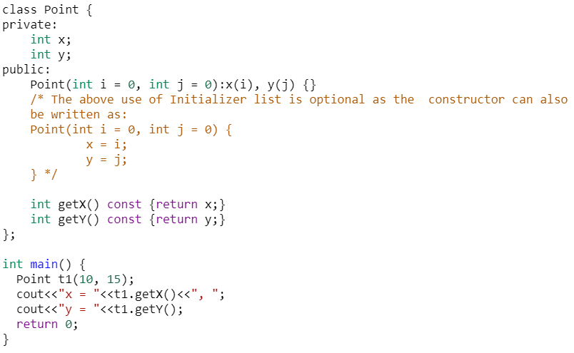
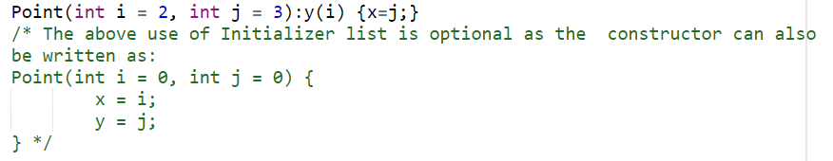
Member Initializer List (Non-const Members)
Notes:
OUTPUT:
x = 10, y = 15

Slide 154
When to use Member Initializer List
You can use initializer list to initialize member variables but it is not necessary
But you must use an initializer list for
Initializing a constant data member
Initializing a reference member

Slide 155
const Class Members
As with member functions, data members can also be const
Constant members must be initialized using member initializer list

Slide 156
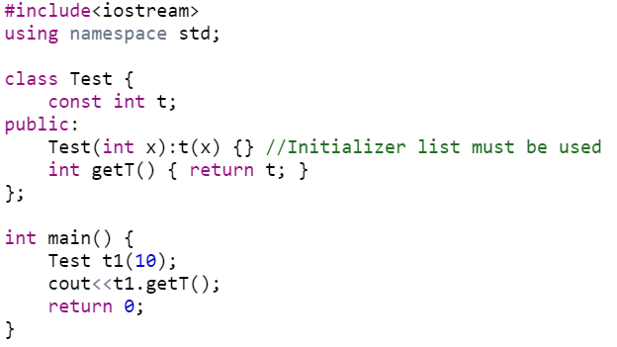
Member Initializer List (non-static const)
Notes:
OUTPUT: 10

Slide 157
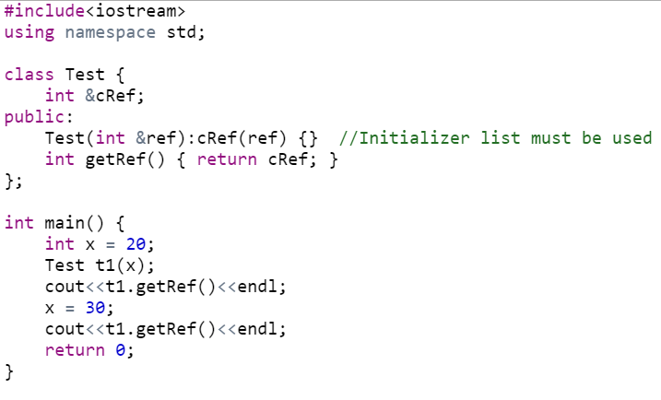
Member Initializer List (References)
Notes:
OUTPUT:
20
30
NOT: IF refrence variable is not initializaed in initialization list and intitliazed within constructor, we get an error message

Slide 158
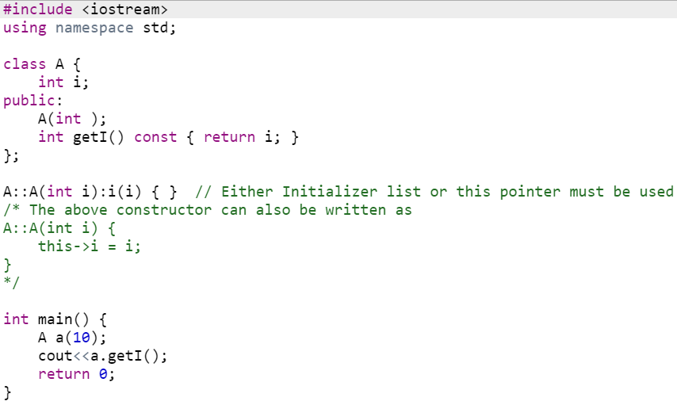
Member Initializer List (parameter name same as data member)
Notes:
OUTPUT:
10

Slide 159
const Objects
Read-only objects
Object data members can only be read, NO write/update of data member allowed
Requires all member functions be const (except constructors and destructors)
const object must be initialized (using constructors) at the time of object creation
Notes:
The const property of an object goes into effect after the constructor finishes executing and ends before the class's destructor executes. So the constructor and destructor can modify the object, but other methods of the class can't.
The reason for this is that the compiler cannot decide whether a method performs write operations or only read operations with data members unless additional information is supplied.

Slide 160
const Objects
const property of an object goes into effect after the constructor finishes executing and ends before the class's destructor executes
So the constructor and destructor can modify the object
Notes:
The const property of an object goes into effect after the constructor finishes executing and ends before the class's destructor executes. So the constructor and destructor can modify the object, but other methods of the class can't.
The reason for this is that the compiler cannot decide whether a method performs write operations or only read operations with data members unless additional information is supplied.

Slide 161
friend Functions and friend Classes
A friend is a function or class that is not a member of a class, but has access to the private members of the class
In other words, a friend function is treated as if it were a member of the class
A friend function can be a regular stand-alone function, or it can be a member of another class.
An entire class can also be declared a friend of another class

Slide 162
friend Functions and friend Classes
To declare a friend function
Type friend before the function prototype in the class that is giving friendship
friend int myFunction( int x );
should appear in the class giving friendship
To declare a friend class
Type friend class Classname in the class that is giving friendship
if ClassOne is granting friendship to ClassTwo,
friend class ClassTwo;
should appear in ClassOne's definition

Slide 163
friend Functions and friend Classes
friend functions and friend classes
Can access private members of another class
Properties of friendship
Friendship is granted, not taken
Not symmetric (if B a friend of A, A not necessarily a friend of B)
Not transitive (if A a friend of B, B a friend of C, A not necessarily a friend of C)

Slide 164
1 // Fig. 7.5: fig07_05.cpp
2 // Friends can access private members of a class.
3 #include <iostream>
setA a friend of class Count (can access private data).
4
5 using std::cout;
6 using std::endl;
7
8 // Modified Count class
9 class Count {
10 friend void setA( Count &, int ); // friend function declaration
11 public:
12 Count() { a = 0; } // constructor
13 void print() const { cout << x << endl; } // output
14 private:
15 int a; // data member
16 };
setA is defined normally and is not a member function of Count.
17
18 // Can modify private data of Count because
19 // setX is declared as a friend function of Count
20 void setA( Count &c, int val )
Changing private variables allowed.
21 {
22 c.x = val; // legal: setX is a friend of Count
23 }
24
25 int main()
26 {
27 Count counter;
28
29 cout << "counter.a after instantiation: ";
30 counter.print();

Slide 165
31 cout << "counter.a after call to setA friend function: ";
32 setA( counter, 8 ); // set a with a friend
33 counter.print();
34 return 0;
35 }
counter.a after instantiation: 0
counter.a after call to setA friend function: 8
private data was changed.

Slide 166
1 // Fig. 7.6: fig07_06.cpp
2 // Non-friend/non-member functions cannot access
3 // private data of a class.
4 #include <iostream>
5
6 using std::cout;
cannotSetA is not a friend of class Count. It cannot access private data.
7 using std::endl;
8
9 // Modified Count class
10 class Count {
11 public:
12 Count() { x = 0; } // constructor
13 void print() const { cout << x << endl; } // output
14 private:
15 int x; // data member
16 };
17
18 // Function tries to modify private data of Count,
19 // but cannot because it is not a friend of Count.
20 void cannotSetA( Count &c, int val )
21 {
22 c.x = val; // ERROR: 'Count::x' is not accessible
23 }
24
cannotSetA tries to modify a private variable…
25 int main()
26 {
27 Count counter;
28
29 cannotSetX( counter, 3 ); // cannotSetX is not a friend
30 return 0;
31 }

Slide 167
Compiling...
Fig07_06.cpp
D:\books\2000\cpphtp3\examples\Ch07\Fig07_06\Fig07_06.cpp(22) :
error C2248: 'x' : cannot access private member declared in
class 'Count'
D:\books\2000\cpphtp3\examples\Ch07\Fig07_06\
Fig07_06.cpp(15) : see declaration of 'x'
Error executing cl.exe.
test.exe - 1 error(s), 0 warning(s)
Expected compiler error - cannot access private data

Slide 168
friend Functions and friend Classes
Friends should be used only for limited purpose
Too many functions declared as friends with private data access, lessens the value of encapsulation

